Slide 1


Natural Language Processing Sequence-to-sequence Models and Attention Mechanisms

Slide 2


Machine Translation
Machine translation plays a pivotal role in the development of NLP.
Many advancements in NLP language models were initially motivated by the need to address translation challenges.
HOW DARE YOU!
你怎麼敢！
Sequence-to-sequence Models and Attention Mechanisms

Slide 3
Challenges of Machine Translation
Unlike the other tasks like classification, the input and output of machine translation are in different lengths.
× We cannot just add an FFN at the end.
√ The hidden state should be utilized to encode the original sequence and it should be passed to the generation process.
Look over there
請看那邊
あそこを見てください
English
Short (3 tokens)
Chinese
(4 tokens)
Japanese
Long (12 tokens)
Sequence-to-sequence Models and Attention Mechanisms

Slide 4
Sequence to sequence Model
Sequence to Sequence (Seq2Seq) model
The core idea of the Seq2Seq model is to map variable-length input sequences to variable-length output sequences.
This flexibility enables its wide application across various tasks, such as:
Machine Translation: Translating a sentence from one language to another.
Text Summarization: Condensing long articles into shorter summaries.
Dialogue Generation: Generating appropriate responses based on input contexts.
Sequence-to-sequence Models and Attention Mechanisms

Slide 5
Sequential Models
Sequence models, also known as time series models, are a class of neural network architectures designed to model sequences of data.
RNN
LSTM
Each output of a sequential model depends on the hidden state variable provided by the previous step.
Sequence-to-sequence Models and Attention Mechanisms

Slide 6
RNN for Sequence Generation
Input Encoding:
The input sequence is fed into the RNN one element at a time.
Hidden State Update:
The RNN updates its hidden state at each time step based on the current input element and the previous hidden state.
Output Generation:
Using the hidden states at each time step, the RNN generates the output sequence one element at a time.
Iteration:
Steps 2-3 are iterated until the desired length of the output sequence is reached or until a specific termination condition is met (e.g., generating an end-of-sequence token).
Sequence-to-sequence Models and Attention Mechanisms

Slide 7
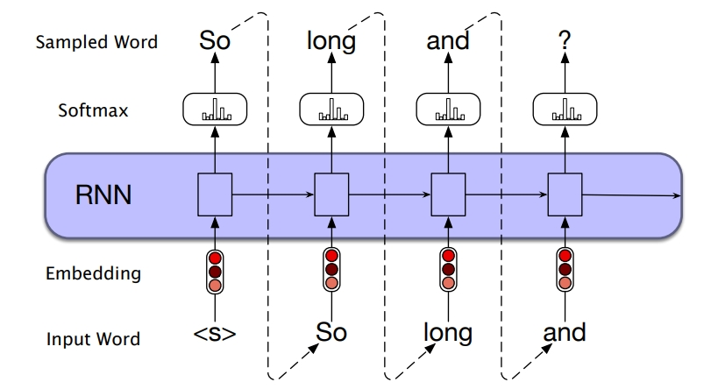
RNN for Sequence Generation
Predict the next token.
From: Stanford NLP
The sequence generation begin with a special token.
Sequence-to-sequence Models and Attention Mechanisms

Slide 8
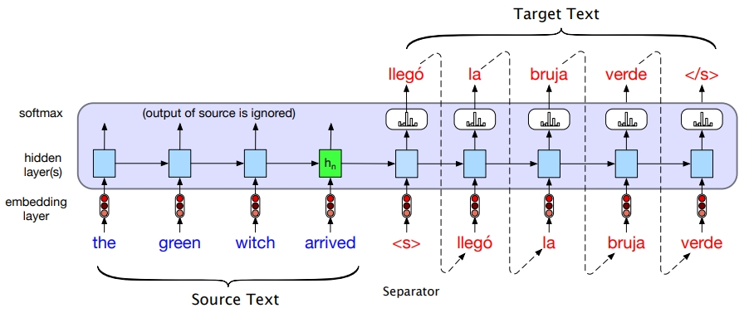
RNN for Machine Translation
Machine translation is a classic application of encoder-decoder architecture.
Encoder
From: Stanford NLP
Context vector
Decoder
Sequence-to-sequence Models and Attention Mechanisms

Slide 9
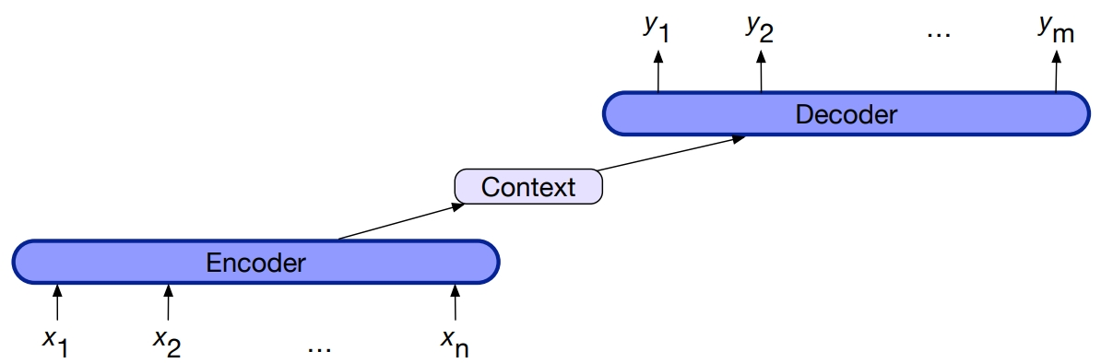
RNN for Machine Translation
The context vector is the last hidden state of the encoder and it contains all the information of the input.
Be a reference of
From: Stanford NLP
The last hidden state
Sequence-to-sequence Models and Attention Mechanisms

Slide 10
Encoder-decoder RNN
Encoder-decoder networks consist of three conceptual components:
An encoder that accepts an input sequence, x1:n, and generates a corresponding sequence of contextualized representations, h1:n.
A context vector, which is a function of h1:n, and conveys the essence of the input to the decoder.
A decoder, which accepts the context vector as input and generates an arbitrary length sequence of hidden states h1:m, from which a corresponding sequence of output states y1:m, can be obtained.
Sequence-to-sequence Models and Attention Mechanisms

Slide 11
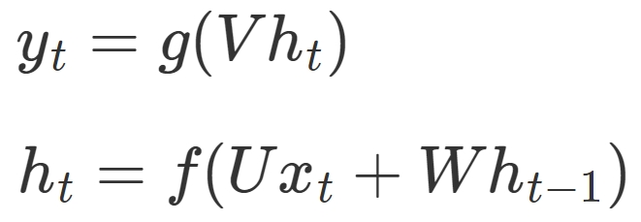
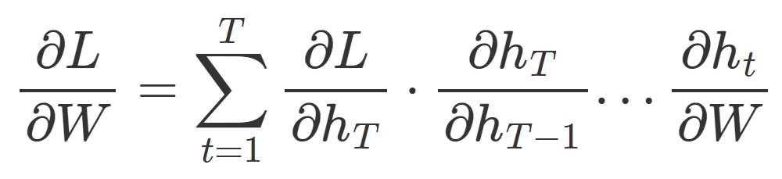
Gradient Vanishing/Exploding Problem of RNN
During backpropagation, gradients are computed with respect to the hidden states through the loss function at each time step.
Compute the gradient (use the parameter W as an example):
The further back in time an input is, the more factors it needs to be multiplied by.
Sequence-to-sequence Models and Attention Mechanisms

Slide 12
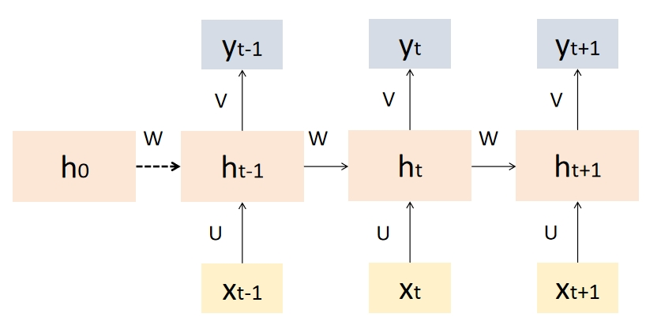
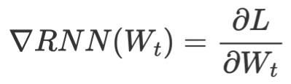
Gradient Vanishing/Exploding Problem of RNN
L
Wt
Sequence-to-sequence Models and Attention Mechanisms

Slide 13
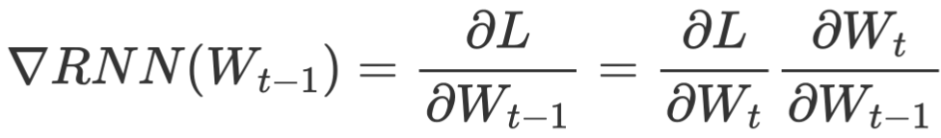
Gradient Vanishing/Exploding Problem of RNN
L
Wt-1
Sequence-to-sequence Models and Attention Mechanisms

Slide 14

Gradient Vanishing/Exploding Problem of RNN
L
W0
If these terms <1, the gradient decays exponentially (gradient vanishing)
If these terms >1, the gradient grows rapidly (gradient exploding)
Sequence-to-sequence Models and Attention Mechanisms

Slide 15
Gradient Vanishing Problem of RNN
Gradient vanishing results in：
Information Loss:
As the number of time steps increases, gradient vanishing prevents RNNs from retaining important information from earlier time steps.
Training Instability:
With the disappearance of gradients in early time steps, the update of network parameters becomes slow or even stagnates.
Difficulty in Generating Long Sequences:
RNNs perform poorly in generating long sequences. Generated sequences may become incoherent or meaningless.
Sequence-to-sequence Models and Attention Mechanisms

Slide 16

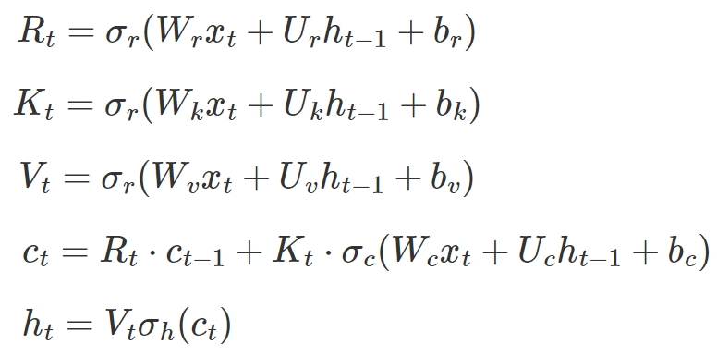
Long Short-Term Memory
Long Short-Term Memory (LSTM) is proposed to solve Gradient Vanishing problem of RNNs.
Forget gate
ct-1
ct
Input gate
Output gate
ht-1
ht
Sequence-to-sequence Models and Attention Mechanisms

Slide 17
Long Short-Term Memory
Forget Gate: It uses a sigmoid function to determines which information from past memory should be forgotten or discarded.
ct-1
ct
ht-1
ht
Forget gate
Sequence-to-sequence Models and Attention Mechanisms

Slide 18
Long Short-Term Memory
Input Gate: It uses a sigmoid function to determine which information should be added to the cell state.
ct-1
ct
ht-1
ht
Input gate
Sequence-to-sequence Models and Attention Mechanisms

Slide 19
Long Short-Term Memory
Candidate Memory: The candidate memory represents potential new information that could be added to the cell state. It is generated by a tanh which is relatively closer to binary than sigmoid.
ct-1
ct
ht-1
ht
Candidate memory
Sequence-to-sequence Models and Attention Mechanisms

Slide 20
Long Short-Term Memory
ct-1
ct
Output Gate: The output gate controls the flow of information from the cell state to the hidden state.
ht-1
ht
Output gate
Sequence-to-sequence Models and Attention Mechanisms

Slide 21
Long Short-Term Memory
LSTM can partially avoid the vanishing gradient problem due to：
gating mechanisms & memory cells.
These components enable LSTM to selectively retain or discard information over time。
It maintains stable gradient flow during training and capture long-term dependencies more effectively compared to traditional RNNs.
Sequence-to-sequence Models and Attention Mechanisms

Slide 22
Problems of time-series
Traditional sequential models, such as simple RNNs, suffer from the following issues:
Vanishing/Exploding Gradients: although LSTM alleviate this problem, it is still existed.
Difficulty in Parallelization: Because sequential models rely on the previous time step's hidden state, they are challenging to parallelize effectively, limiting their training efficiency on large-scale datasets and the size-growth of language models.
Sequence-to-sequence Models and Attention Mechanisms

Slide 23
Attention Mechanisms
The attention mechanism solve the gradient problems and provided a parallelizable solution of LMs.
Core Idea: To enable a model to focus on the most relevant parts of the input sequence when making predictions or generating outputs.
Attention
Attention with RNNs
Attention without RNNs
From Google Seq2seq
Sequence-to-sequence Models and Attention Mechanisms

Slide 24
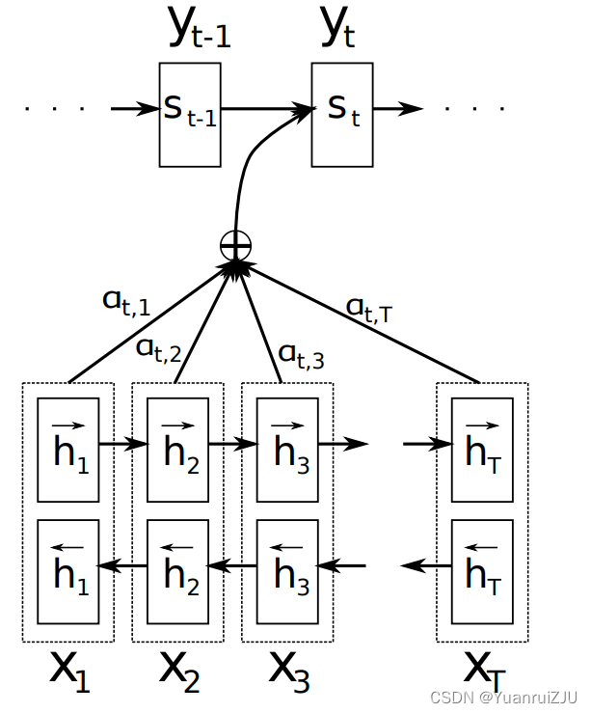
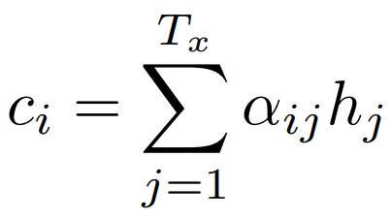
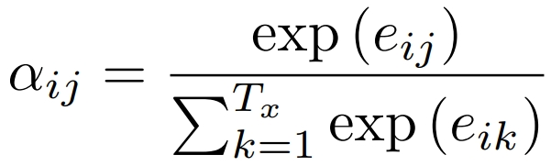

Attention
At the beginning the attention is associated with RNNs.
Weighted summarize
Where
is an alignment model which scores how well the inputs around position j and the output at position i match
From: Attention 2015
Sequence-to-sequence Models and Attention Mechanisms
Notes:
只是看更多, 但一樣得等看完全部才能算weight

Slide 25
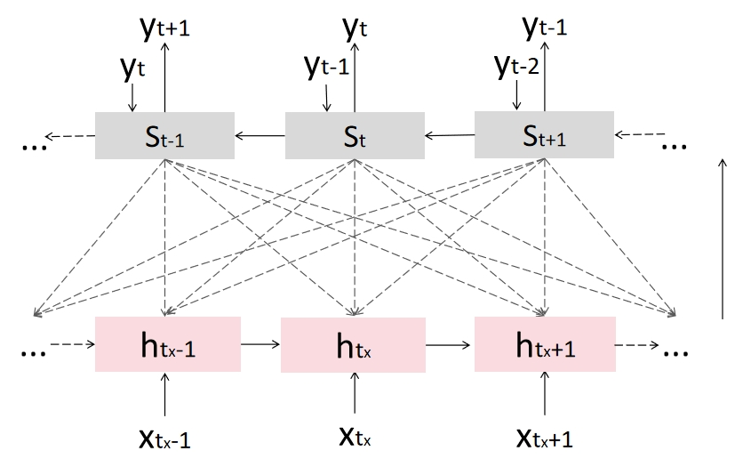
Attention
When computing the new hidden state st, attention mechanism compute attention scores with all the input tokens (from a bidirectional RNN).
Sequence-to-sequence Models and Attention Mechanisms

Slide 26
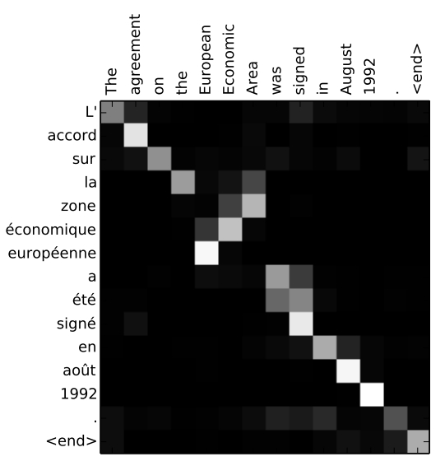
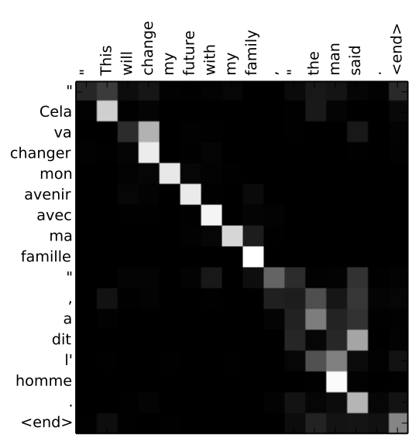
Attention
An example of machine translation.
From: Attention 2015
Sequence-to-sequence Models and Attention Mechanisms

Slide 27
Attention without RNNs
It has been proposed to eliminate the RNN component due to:
The primary function of the RNN is to extract and process sequential features. However, this functionality can be achieved using simpler methods, leading to reduced computational complexity.
RNNs are not parallelizable, meaning they cannot efficiently process multiple input sequences simultaneously, which limits their scalability and efficiency in large-scale applications.
Sequence-to-sequence Models and Attention Mechanisms

Slide 28
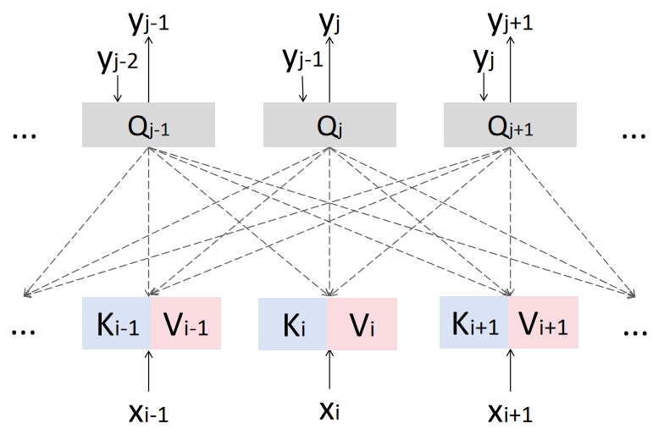
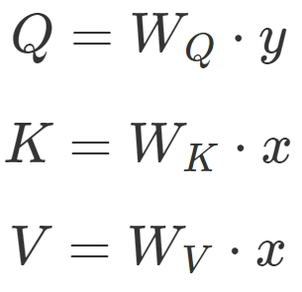
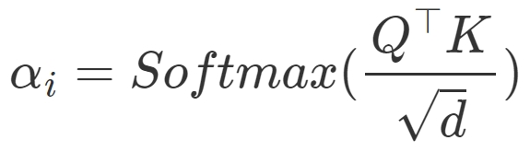
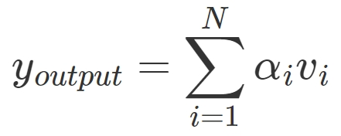
Attention without RNNs
Learnable weight matrix
output
input
Attention score:
Sequence-to-sequence Models and Attention Mechanisms

Slide 29
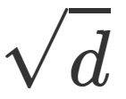



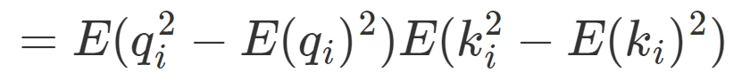

Why
The model's parameters should undergo normalization, ensuring their average is 0 and variance is 1.
Assume that qi and ki are random variable with average 0 and variance 1:
Sequence-to-sequence Models and Attention Mechanisms

Slide 30
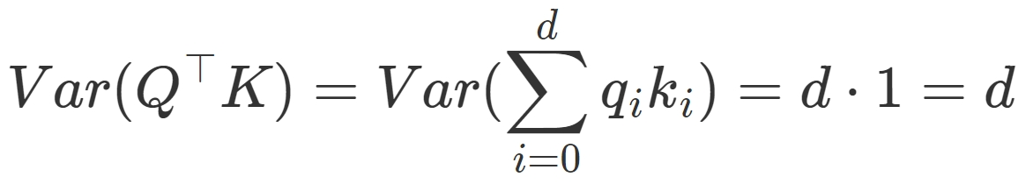
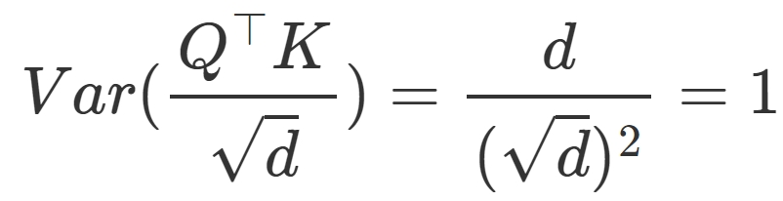
Why
However, after we multiply Q and K, the variance becomes d:
So it should be divided by :
Sequence-to-sequence Models and Attention Mechanisms

Slide 31
Summary
Sequential Models:
RNN: Recurrent Neural Network, the fundamental NN in NLP tasks.
LSTM: A modification of RNNs designed to alleviate gradient issues.
Attentions:
Attention with RNN: Avoid gradient vanishing in RNNs.
Attention without RNN: Parallelizable and simpler.
Sequence-to-sequence Models and Attention Mechanisms

Slide 32
Reference
Stanford NLP:
https://web.stanford.edu/~jurafsky/slp3/
Attention 2015:
Bahdanau, D., Cho, K., & Bengio, Y. (2014). Neural machine translation by jointly learning to align and translate. arXiv preprint arXiv:1409.0473.

